Slide 1


QA Working Introduction

Slide 2


Agenda
01
Software Development Introduction
02
QA Job Introduction
03
Exercise
04
Q&A

Slide 3
01
Software Development Introduction
Supporting text here…

Slide 4
Software Development Mode
Agile development (敏捷开发):
开发中
开发中
发布计划
Stories
Defects
版本发布1
……
发布计划n
Stories
Defects
版本发布n
Iteration (迭代)
Story: New functions to develop
Defect: Bug; UI adjustments

Slide 5
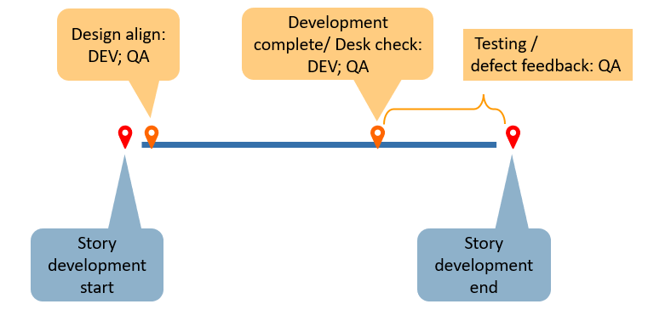
Software Development Cycle
Week 1 |  |  |  |  | Week 2 |  |  |  |  | Week 3 |  |  |  |  | Week 4 |  |  |  |  | Week 5 |  |  |  |  | Week 6
Mon | Tue | Wed | Thur | Fri | Mon | Tue | Wed | Thur | Fri | Mon | Tue | Wed | Thur | Fri | Mon | Tue | Wed | Thur | Fri | Mon | Tue | Wed | Thur | Fri | Mon | Tue | Wed | Thur | Fri
Iteration 1
IPM
Development and Test
Regression
Retro
Iteration 2
IPM
Development and Test
Regression
Story Cycle:

Slide 6





Software Development Cycle
Week 1 |  |  |  |  | Week 2 |  |  |  |  | Week 3 |  |  |  |  | Week 4
Mon | Tue | Wed | Thur | Fri | Mon | Tue | Wed | Thur | Fri | Mon | Tue | Wed | Thur | Fri | Mon | Tue | Wed | Thur | Fri
Standup Meeting
 |  |  | IPM | Development and Test |  |  |  |  |  |  |  |  |  |  |  |  | Regression
BA&DEV&QA:
Update the working progress
Raise the problem if need assistance
Retro
BA:
Schedule and share the Iteration Items (Story/Defect)
DEV:
Estimate the Dev Workload for each story
QA:
Understand the stories’ requirement and AC
BA:
Review test cases
Schedule the new defect if has
DEV:
Develop the function or fix the defect
Desk check for completed function
Fix the defect
QA:
Write and share the test cases
Test on Story or Defect
Confirm and register the defect if has
BA&DEV&QA:
Share the idea or advise during work/life for last iteration
BA:
Schedule the new defect if has
DEV:
Fix the defect if has
QA:
Process regression test
Register the defect if has

Slide 7

Software Development Mode - Responsibility Summary
BA
Business analysis, requirement analysis, requirement arrangement
DEV
Function develop, defect fix, environmental maintenance
QA
Quality assurance

Slide 8
02
QA Job Introduction
Supporting text here…

Slide 9
04
Q&A
Supporting text here…

Slide 10

Thank You!

